Slide 1
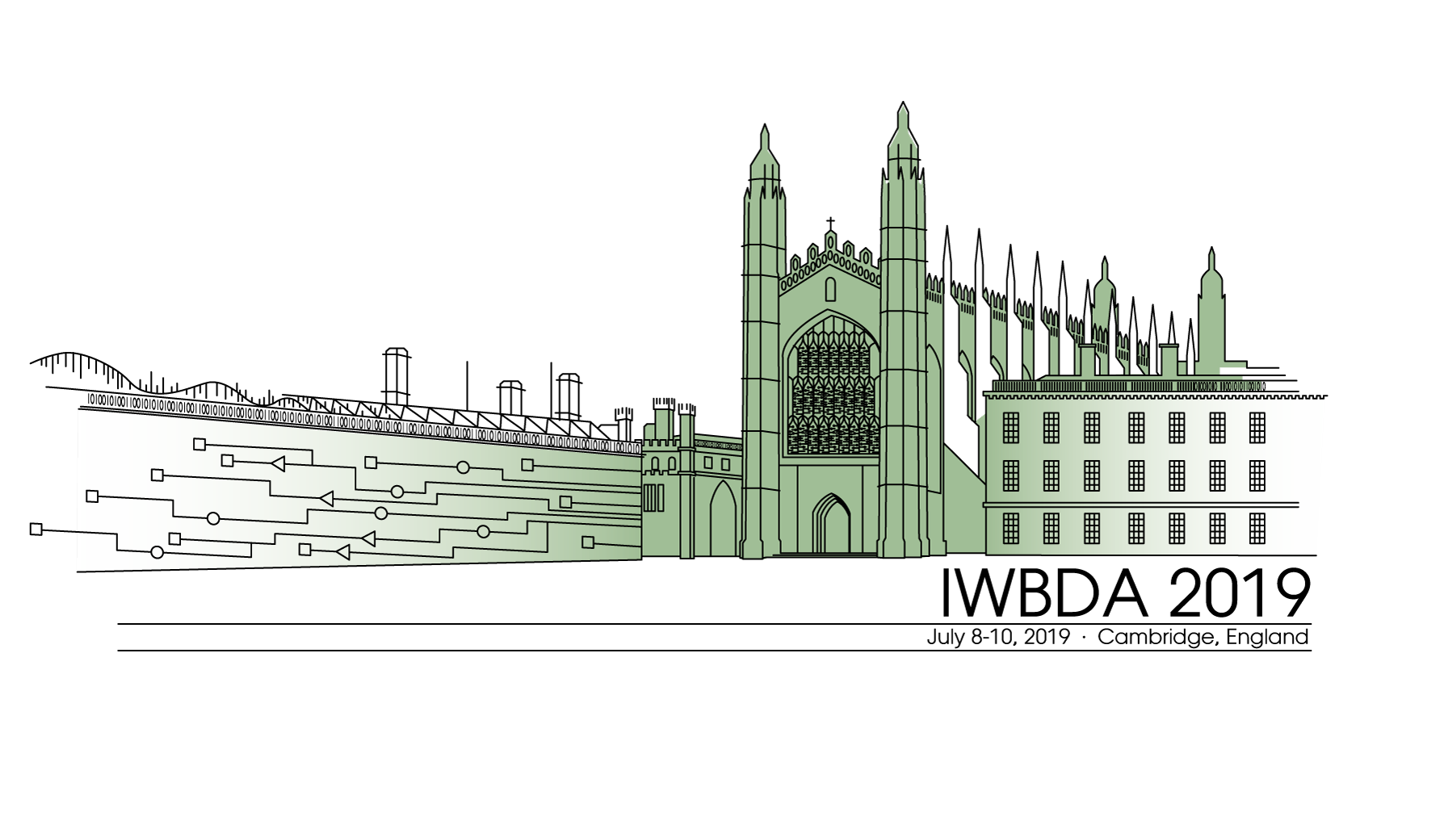
Automated Model Reduction for Biological Circuits
10th Jul. 2019
Ayush Pandey

Slide 2
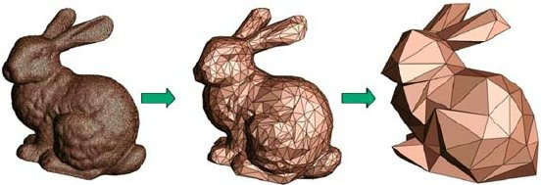
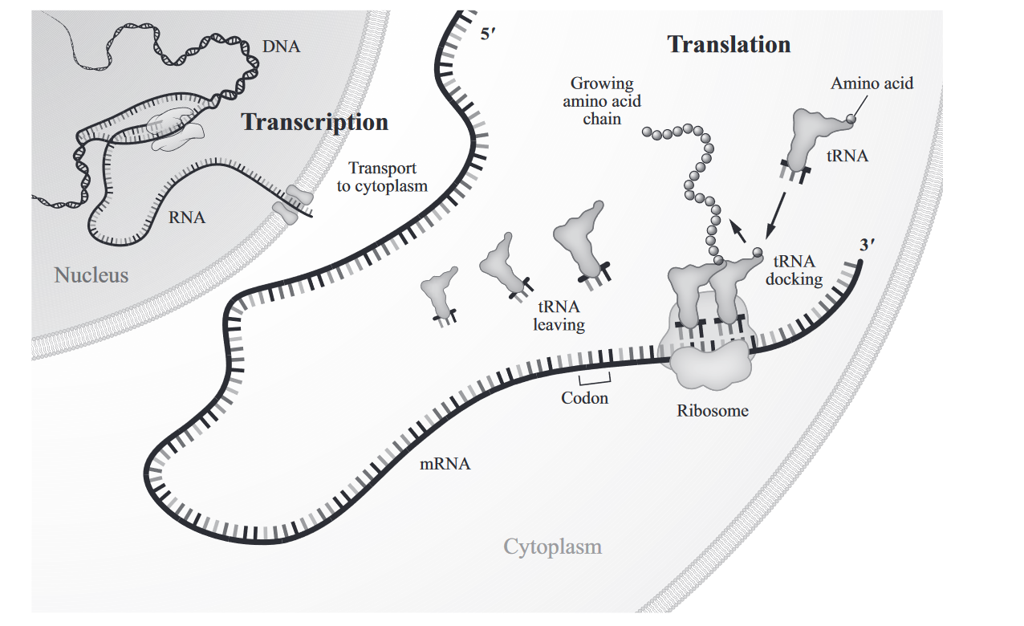
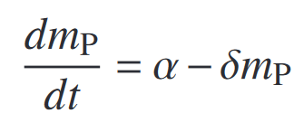
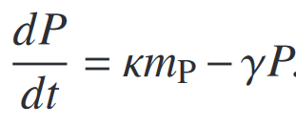
Model Reduction
From mass-action CRN models to Hill function based minimal models.
Existing tools easily create CRN models (iBioSim, txtlsim etc).
Utilizing time-scale separation along with other methods.
Why?
Improving parameter identifiability.
Structured model reduction can help guide experiments.
Image taken from Schilders, Wil. "Introduction to model order reduction." Model order reduction: Theory, research aspects and applications. Springer, Berlin, Heidelberg, 2008. 3-32.
Image taken from - Del Vecchio, Domitilla, and Richard M. Murray. Biomolecular feedback systems. Princeton, NJ: Princeton University Press, 2015..

Slide 3
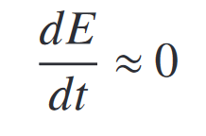
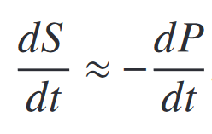
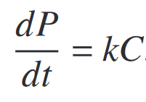
Two structured model reduction approaches
Enzymatic Reaction
Singular Perturbation Theory
Quasi-steady state approximation
Strict conditions need to be satisfied.
Finding $ε$ not always possible for complicated models.
Guaranteed error bounds.
Heuristics based.
May or may not be correct, depending on assumptions.
No guarantee for error bounds.

Slide 4
Our approach
Full model $(n)$
Reduced model $(n −2)$
$$\dot{x}=f\left(x, Θ\right) \\ y=Cx$$
$$\dot{\hat{x}}=\hat{f}\left(\hat{x}, Θ\right) \\ \hat{y}=\hat{C}\hat{x}$$
$${\dot{x}}_{1}=f_{1}\left(x, Θ\right)$$
While …
Automatically finding the right combination of states to collapse.
Minimizing the error between the outputs
Minimizing the sensitivity of error with respect to parameters
$${\dot{x}}_{2}=f_{2}\left(x, Θ\right) \\ {\dot{x}}_{3}=f_{3}(x, Θ)$$
$$x_{2}=h_{2}\left(x, Θ\right) \\ x_{3}=h_{3}(x, Θ)$$
$${\dot{x}}_{1}=f_{1}\left(x, Θ\right)$$
$${\dot{x}}_{2}=f_{2}\left(x, Θ\right) \\ {\dot{x}}_{3}=f_{3}(x, Θ) \\ . \\ . \\ . \\ {\dot{x}}_{n}=f_{n}(x, Θ)$$
$$. \\ . \\ . \\ {\dot{x}}_{n}=f_{n}(x, Θ)$$

Slide 5
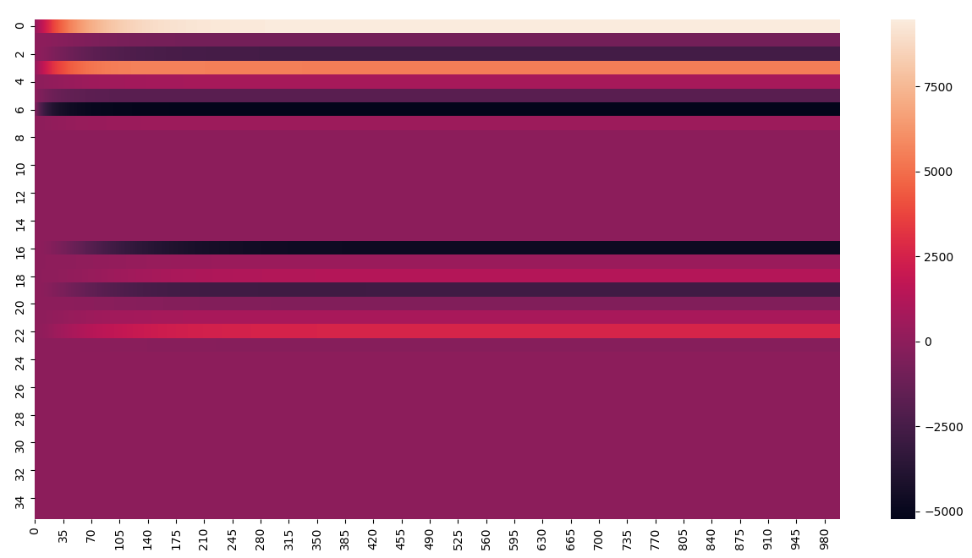
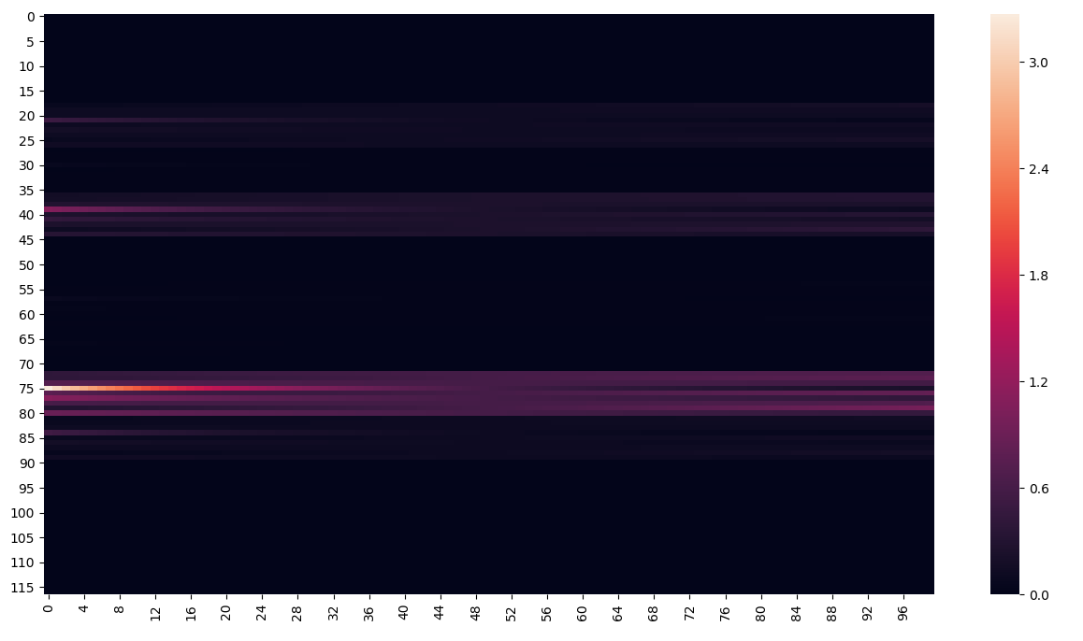
The algorithm – Overview
Model Input
Attempts
Automated model reduction algorithm
Reduced Model #1
Reduced Model #2
Reduced Model #3

Slide 6
The algorithm – Overview
Minimize normed error, $e=y −\hat{y},$ for all time
Model Input
Minimize sensitivity of error, $S_{e}=\frac{∂e}{∂θ},$ wrt all parameters
Model Reduction
Algorithm
Fast convergence, least number of states

Slide 7
The algorithm – Details
Model Input
Attempts
Algorithm
$$\arg{\min{W_{1}e+W_{2}S_{e}}}$$
$$y=Cx, \hat{y}=\hat{C}\hat{x}$$ $e=\left||y −\hat{y}\right|$| $$S_{e}=\frac{∂e}{∂θ}$$
$$x=T [ \hat{x} x_{c}]′$$
$$\dot{x}=f\left(x, θ\right)$$
$\dot{\hat{x}}=\hat{f}\left(\hat{x}, θ\right)$
Reduced Model #1
$$\arg{\min{W_{1}e+W_{2}S_{e}}}$$
$$y=Cx, \hat{y}=\hat{C}\hat{x}$$ $e=\left||y −\hat{y}\right|$| $$S_{e}=\frac{∂e}{∂θ}$$
$$x=T [ \hat{x} x_{c}]′$$
$$\dot{x}=f\left(x, θ\right)$$
$\dot{\hat{x}}=\hat{f}\left(\hat{x}, θ\right)$
Post reduction analysis
Error tolerance
Sensitivity
# states …
Reduced Model
Reduced Model #2
Reduced Model #3

Slide 8
The algorithm – Details
Model Input
Attempts
Algorithm
$$\arg{\min{W_{1}e+W_{2}S_{e}}}$$
$$y=Cx, \hat{y}=\hat{C}\hat{x}$$ $e=\left||y −\hat{y}\right|$| $$S_{e}=\frac{∂e}{∂θ}$$
$$x=T [ \hat{x} x_{c}]′$$
$$\dot{x}=f\left(x, θ\right)$$
$\dot{\hat{x}}=\hat{f}\left(\hat{x}, θ\right)$
Reduced Model #1
$$\arg{\min{W_{1}e+W_{2}S_{e}}}$$
$$y=Cx, \hat{y}=\hat{C}\hat{x}$$ $e=\left||y −\hat{y}\right|$| $$S_{e}=\frac{∂e}{∂θ}$$
$$x=T [ \hat{x} x_{c}]′$$
$$\dot{x}=f\left(x, θ\right)$$
$\dot{\hat{x}}=\hat{f}\left(\hat{x}, θ\right)$
Post reduction analysis
Error tolerance
Sensitivity
# states …
Reduced Model
Reduced Model #2
Reduced Model #3

Slide 9
Theoretical results
Papachristodoulou, Antonis, et al. "Structured model reduction for dynamical networked systems." 49th IEEE Conference on Decision and Control (CDC). IEEE, 2010.
(for linear dynamics)
Brute force or approximation methods for nonlinear dynamics
Pandey, Ayush, and Richard M. Murray. "An automated model reduction tool to guide the design and analysis of synthetic biological circuits." bioRxiv (2019): 640276.
For both linear and nonlinear dynamics

Slide 10
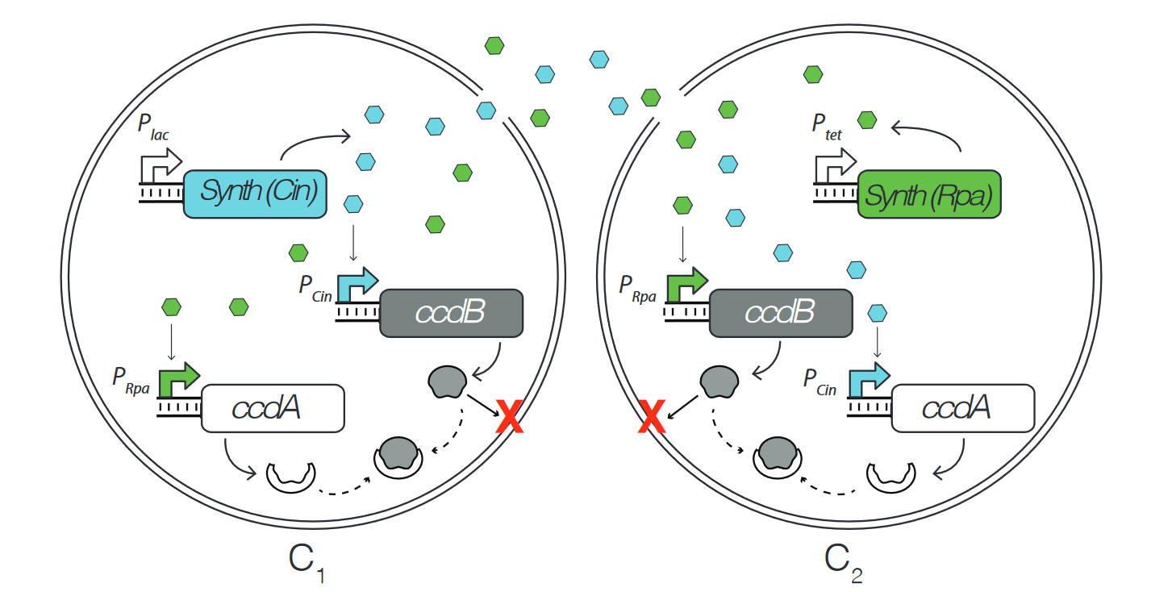
Population and composition control circuit
AHL signals
Species | Description
C_{i} | Cell count
T_{i} | Average toxin concentration
A_{i} | Average anti-toxin concentration
S_{i} | Signal (AHL) concentration
Anti-Toxin rescues
Toxin induced killing

Slide 11
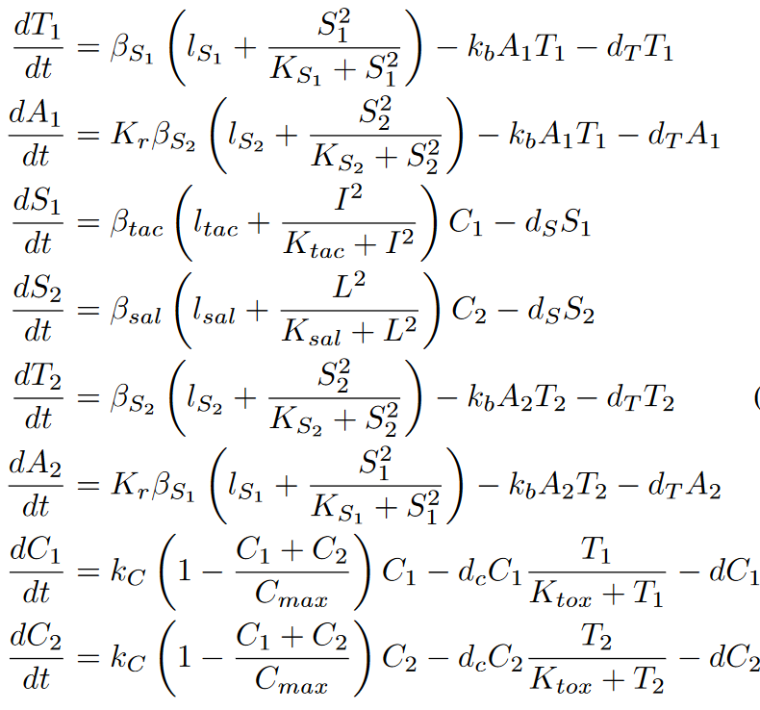
8 species | 24 parameters
2 measurements | 2 inputs
How to use the model to guide the experimental design?
How to identify all parameters?

Slide 12
Full model
States : T₁, A₁, T₂, A₂, S₁, S₂, C₁, C₂
Possible reduced states
Retained states (outputs)

Slide 13
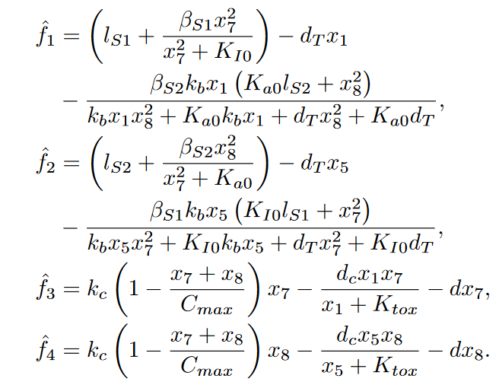
Full model
Reduced model
States : T₁, A₁, T₂, A₂, S₁, S₂, C₁, C₂
Retained states : T₁, T₂, C₁, C₂
Possible reduced states
Retained states (outputs)
Lumped parameters

Slide 14
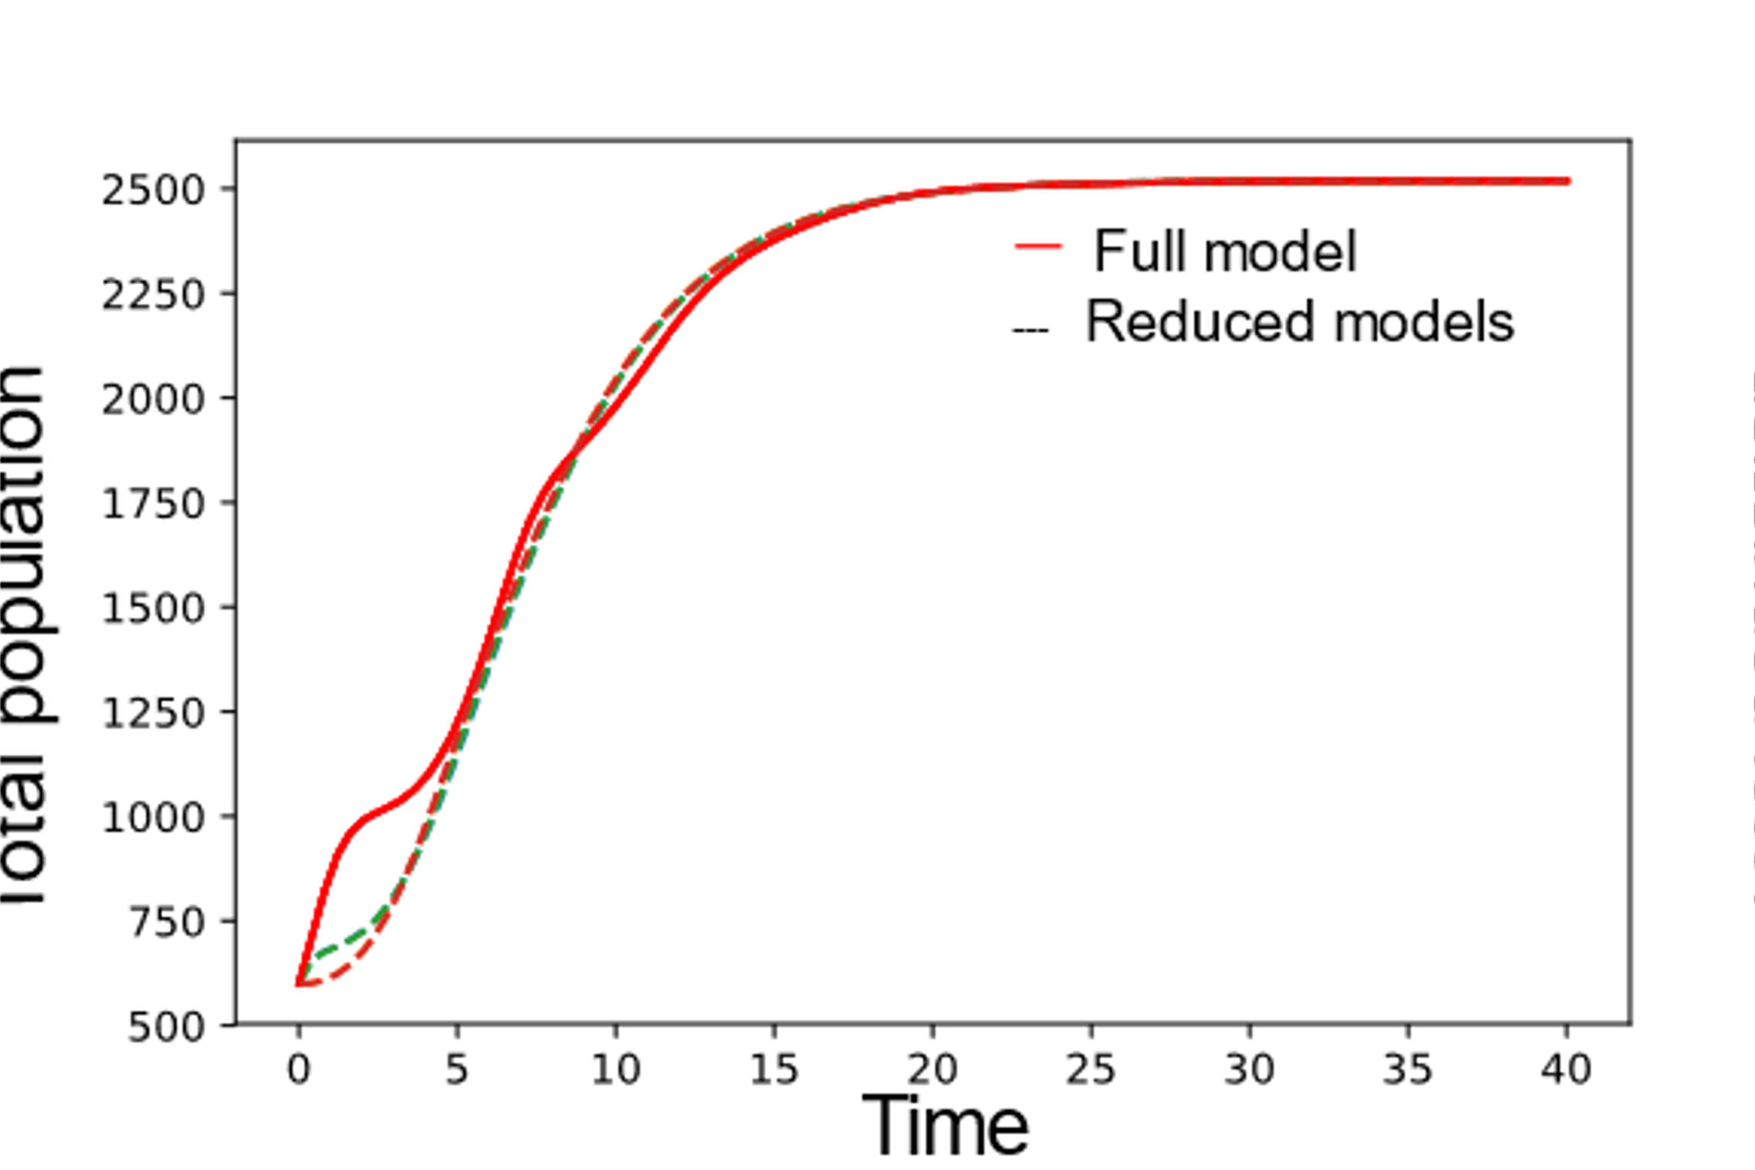
Total population – full model vs reduced models
Full model
Possible retained states :
T₁, T₂, C₁, C₂
A₁, A₂, C₁, C₂
T₁, A₂, C₁, C₂
A₁, T₂, C₁, C₂
States : T₁, A₁, T₂, A₂, S₁, S₂, C₁, C₂
Total population
We are only looking at the error metric here
$e=\left||y −\hat{y}\right|$|
Possible reduced states
How to choose?
Retained states (outputs)

Slide 15
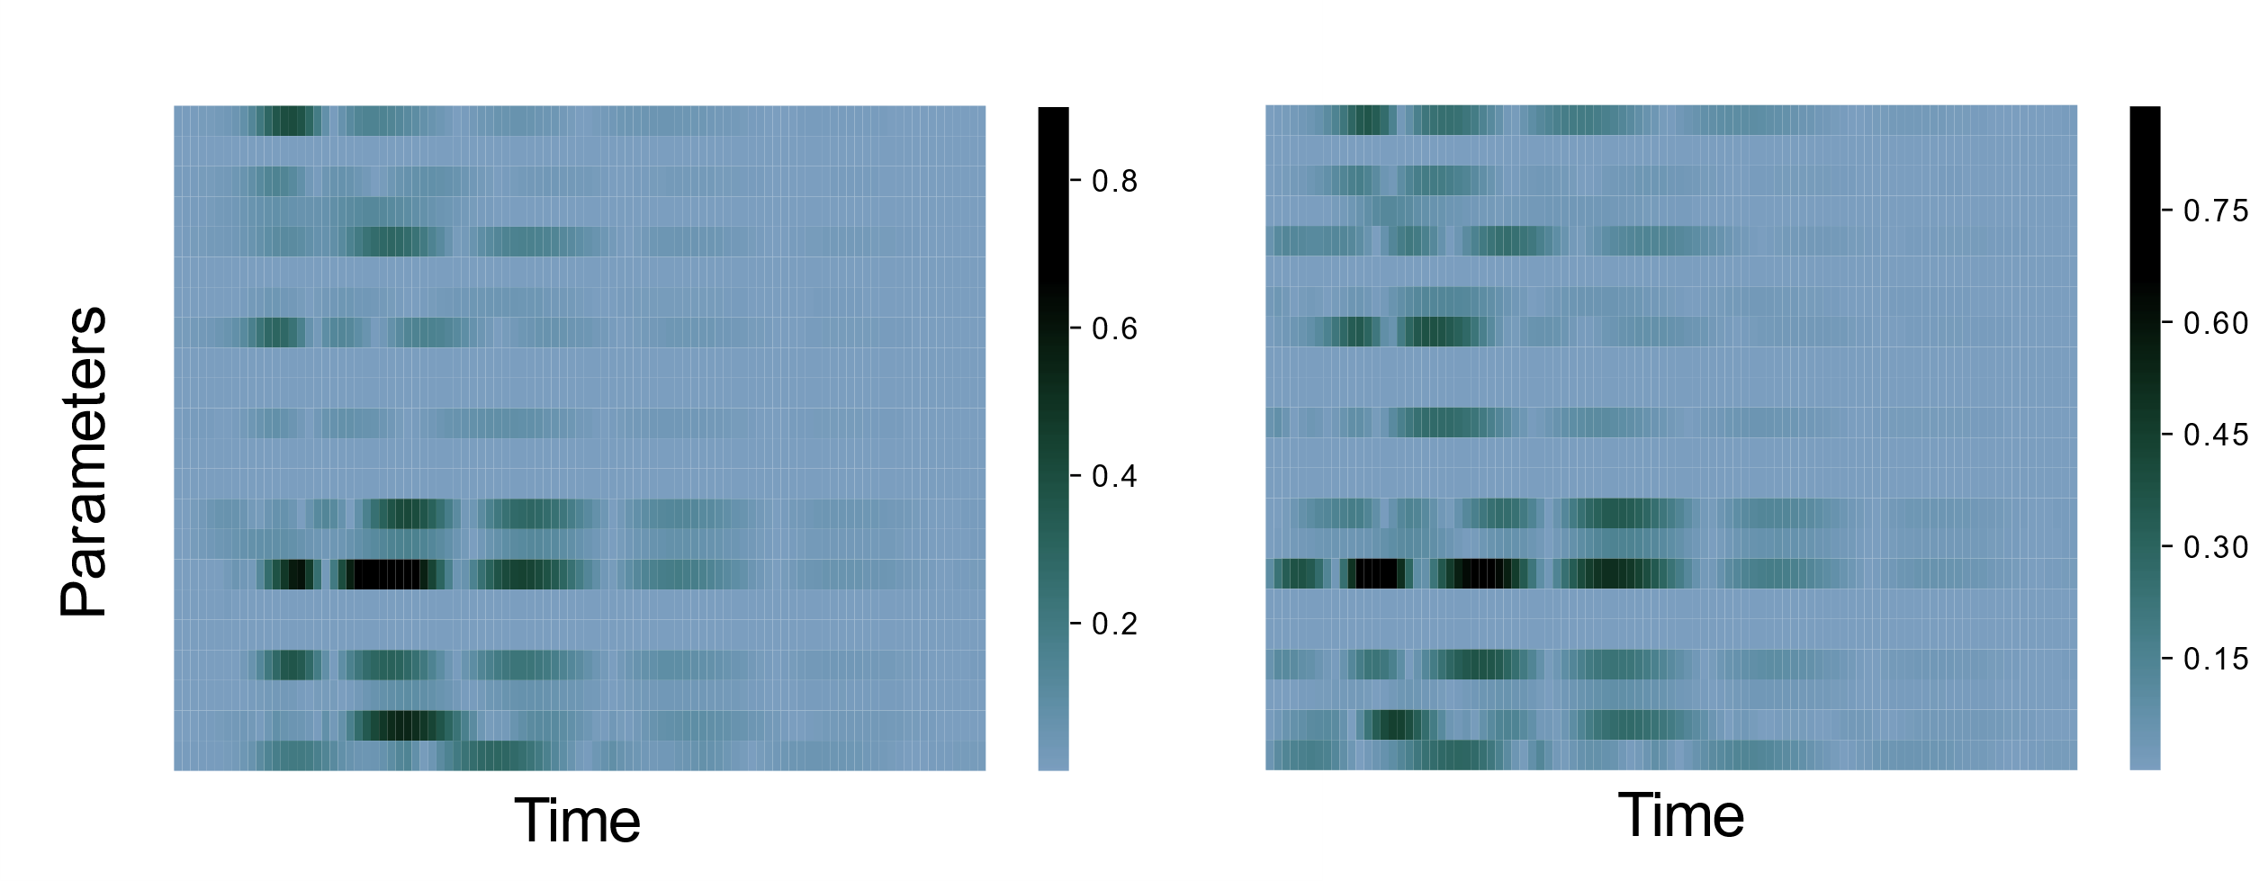
Sensitivity analysis of different reduced models determines the model with the best robust performance

Slide 16
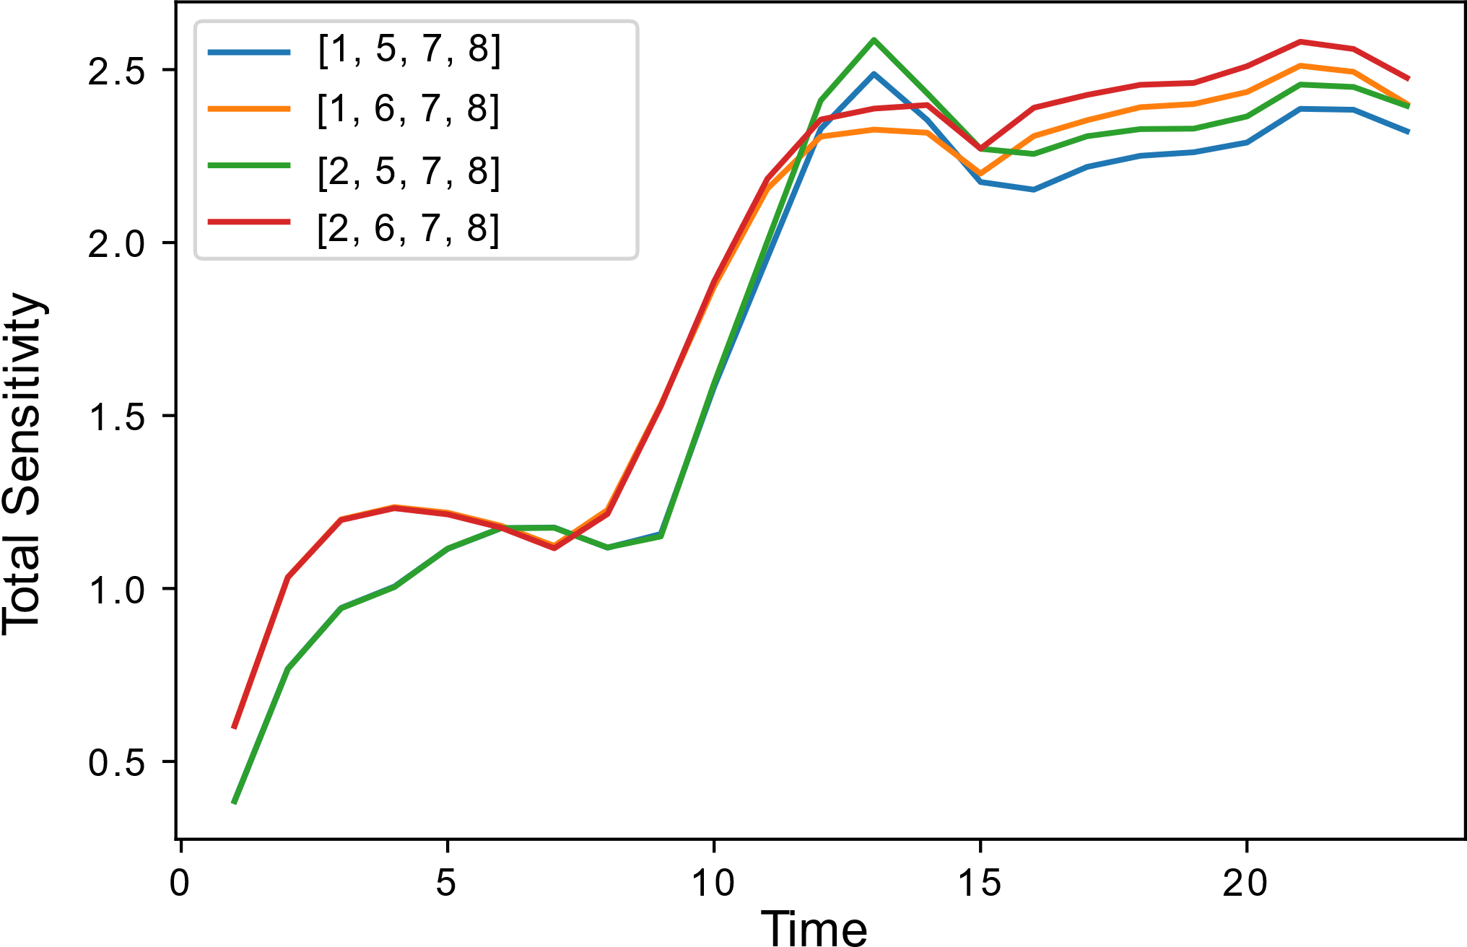
Total sensitivity plots reveal the robust reduced model

Slide 17
Full model
Reduced model
States : T₁, A₁, T₂, A₂, S₁, S₂, C₁, C₂
Retained states : T₁, T₂, C₁, C₂
Possible reduced states
Retained states (outputs)
Lumped parameters

Slide 18
Python tool – SBMLReduce
Usage example –
import SBMLReduce as sr
sr.timepoints = np.linspace(0,100,100)
sr.error_tolerance = 10
sr.C = np.array(…) # Write output matrix
x, f, P = sr.load_ODE_model(n = 8)
# Write ODEs now, f[0] = …
sr.compute_reduced_model()
f_hat = sr.get_reduced_model(‘Sympy’)
f_hat_SBML = sr.get_reduced_model(‘SBML’)
……
Available on Github:
ayush9pandey/sbmlReduce/
Built with Python Sympy, and libSBML

Slide 19
Conclusion
Automated algorithm based on QSSA but with error convergence bounds.
Bound on sensitivity of error guarantees robust performance.
Open questions :
How generalizable to bigger models?
From CRNs to minimal Hill function models.
Thank you for your attention!
Check out Github – ayush9pandey
Email : apandey@caltech.edu
Murray Biocircuits Group
The project or effort depicted was or is sponsored by the Defense Advanced Research Projects Agency (Agreement HR0011-17-2-0008). The content of the information does not necessarily reflect the position or the policy of the Government, and no official endorsement should be inferred.

